Slide 1
HOTEL BOOKING ANALYSIS
Presented
by
Ankit Sharma
&
Team Member

Slide 2
AGENDA
- Introduction of what Data are containing
- Data Wrangling
- EDA(Exploratory Data Analysis)
- Data Visualisation
- Conclusion

Slide 3
Introduction
This project contains the real world data record of hotel bookings of a city and a resort hotel containing details like bookings, cancellations, guest details etc. from 2015 to 2017.
This data set contains booking information for a city hotel and a resort hotel and includes information such as when the booking was made, length of stay, the number of adults, children, and/or babies, and the number of available parking spaces, among other things. All personally identifying information has from the data.

Slide 4
Data wrangling
Data Cleaning:
This data file consist of Null values ‘NaN’.
Replaced those null values with zeros.
Data Preparation:
Data file consist of different type of data type.
Data types: Integers, Float, Objects
Converted the float data type in integer data type

Slide 5
Data analysis
Understanding of Data what is Containing.
Which Hotel has more bookings.
Visitors analysis in different year.
Cancellations in both Hotel
Analysis of booking across different year, months and days
Night stay analysis
Market segment analysis
Distribution channel analysis
Deposit policy of hotel
Meal preference analysis
Overview of guest
Correlations
Country wise analysis

Slide 6
Analysis of hotel dataframe
This Dataset have Containing of 1,19,390 rows and 32 columns of Data.
The data set has different columns name- ( hotel', 'is_canceled', 'lead_time', 'arrival_date_year', 'arrival_date_month', 'arrival_date_week_number', 'arrival_date_day_of_month', 'stays_in_weekend_nights', 'stays_in_week_nights', 'adults', 'children', 'babies', 'meal', 'country', 'market_segment', 'distribution_channel', 'is_repeated_guest', 'previous_cancellations', 'previous_bookings_not_canceled', 'reserved_room_type', 'assigned_room_type', 'booking_changes', 'deposit_type', 'agent', 'company', 'days_in_waiting_list', 'customer_type', 'adr', 'required_car_parking_spaces', 'total_of_special_requests', 'reservation_status', 'reservation_status_date)

Slide 7
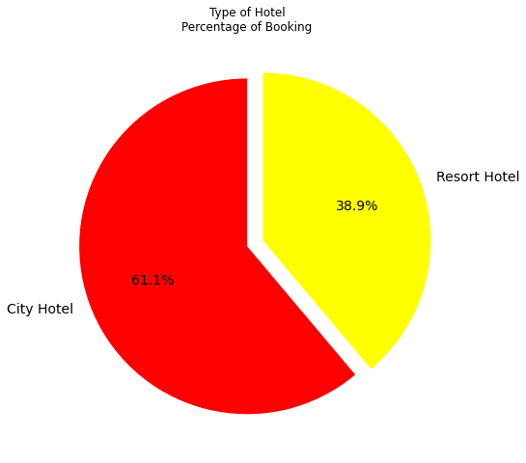
Data visualization
The pie chart show percentage of booking analysis of hotel ie, in city hotel and resort hotel
The no of booking in city hotel is more than resort hotel

Slide 8
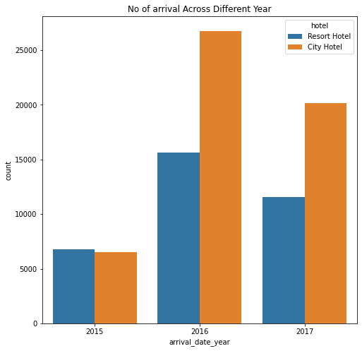
Booking across different year - In 2015 Both Hotels have Same Visiters Around 6,000 - 7,000. - In 2016 both hotels get More customers 1. Resort hotel visiters count are around 16,000 2. City hotel visiters count are around 27,000 It Means City Hotel visiter count takes a massive growth by more than 4 times.

Slide 9
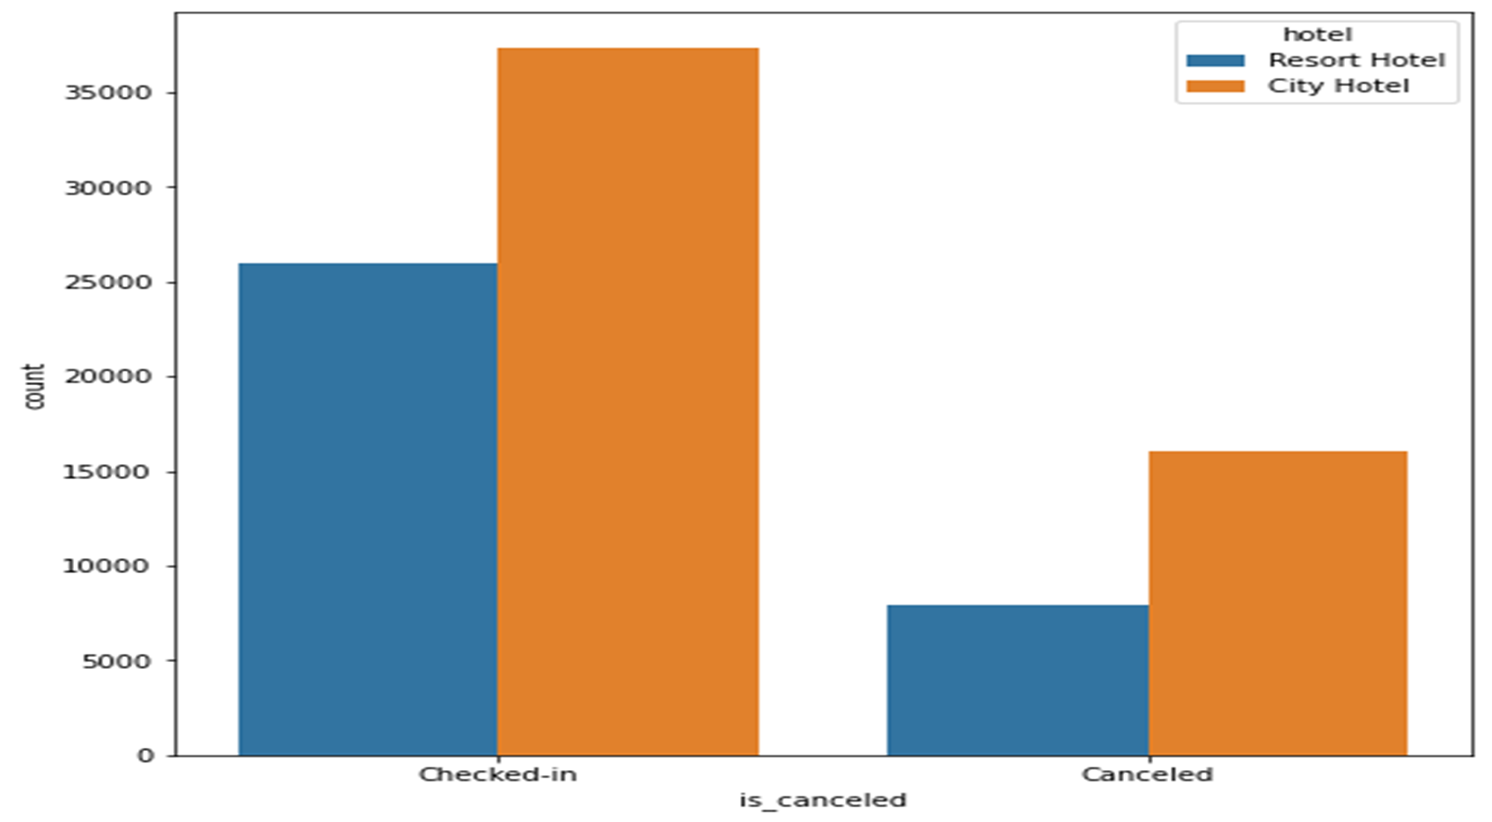
- Total Booking are Around 1,19,390 and totel Canceled booking are more than 44,000 - City Hotel has 43% Cancellation whereas Resort Hotel has 28% Cancelation. - It Means City Hotel has Loosing his Kinds more than Resort Hotel
Cancellation Analysis between Hotels

Slide 10
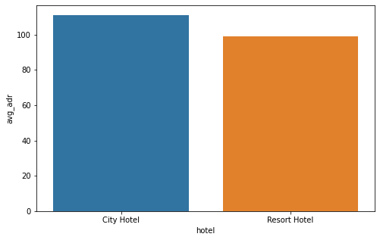
As per ADR report, revenue collection of the city hotel is more than resort hotel.

Slide 11
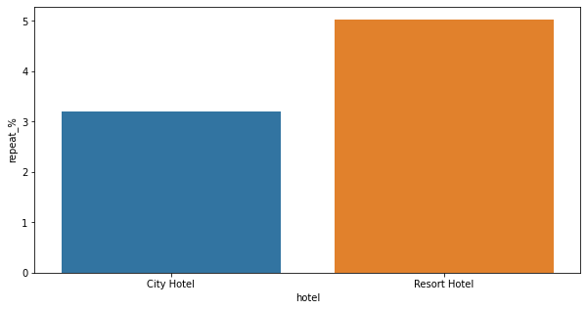
Repeat Customer’s percentage
- City Hotel has round 3% Repeat Customers
- Resort Hotel has Round 5% Repeat Customers

Slide 12
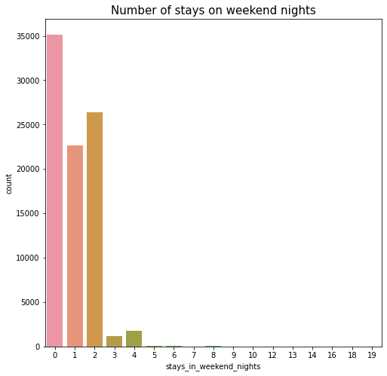
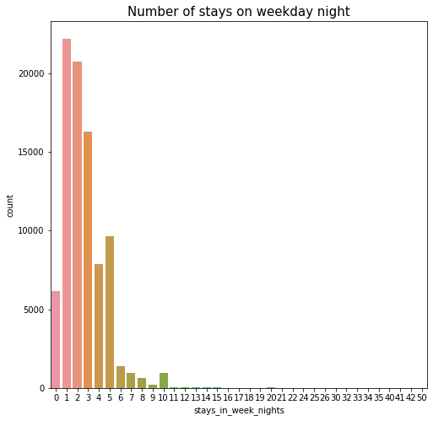
Night stay duration

Slide 13
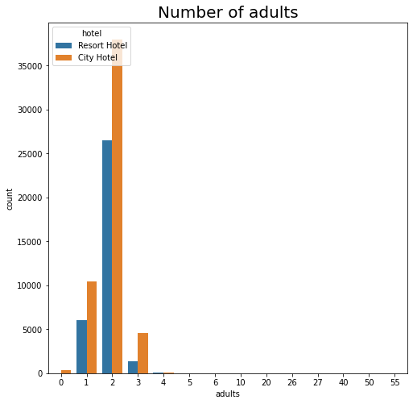
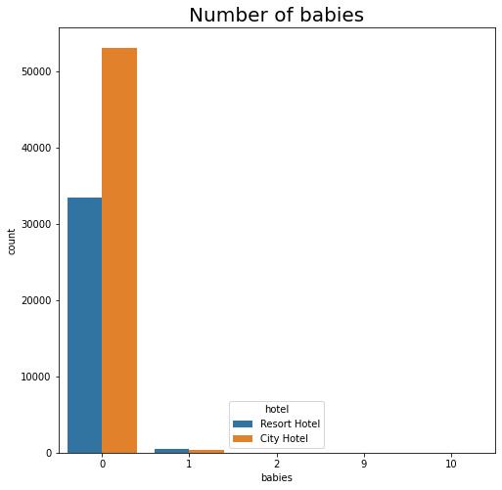
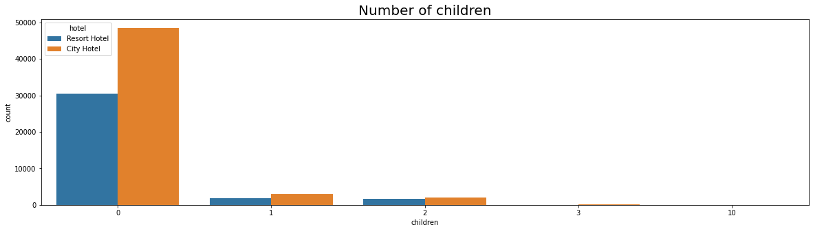
Type of visitor : Adults, children, babies

Slide 14
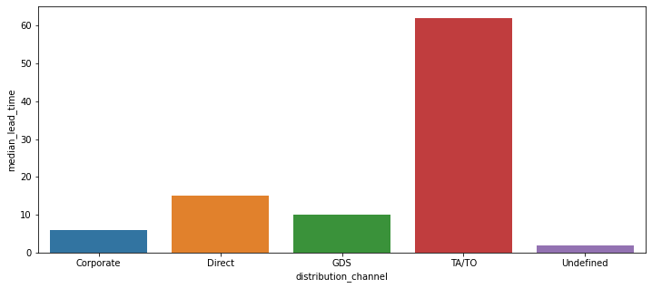
Distribution channel analysis by median lead time
- Most of Visiters are came through Online TA Channel in both hotel
- 2nd Most visiters are came Direct.

Slide 15
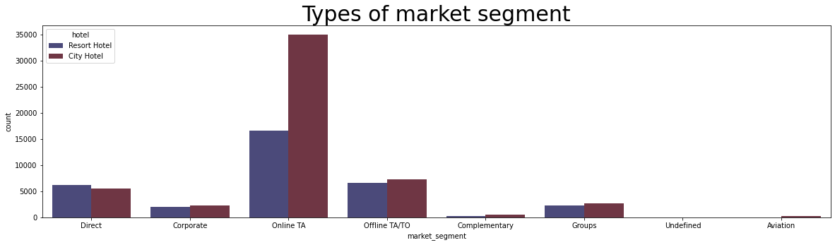
Market Segment

Slide 16
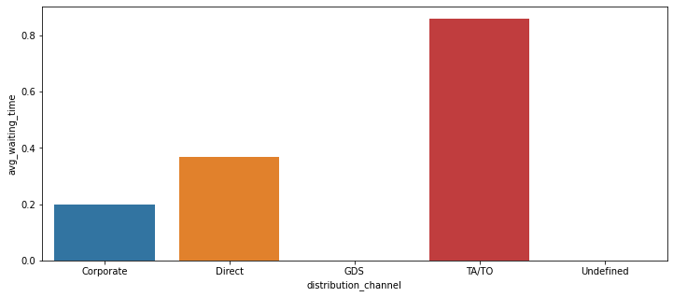
Distribution channel analysis by average waiting time

Slide 17
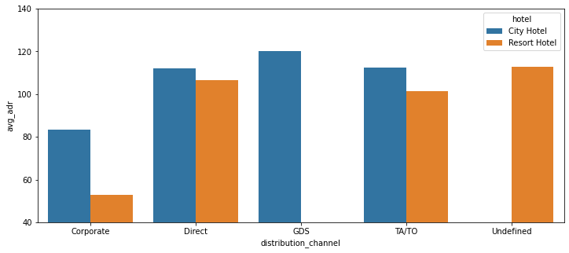
Distribution channel analysis by average ADR

Slide 18
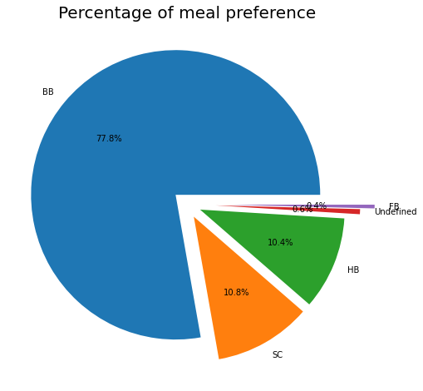
Meal preference
- The most preferred meal is ‘BB’
-The least preferred Meal is ‘FB’

Slide 19
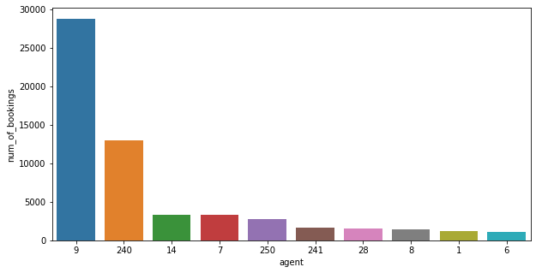
No of booking according to agent
- Most Active Agent no. is 9
- Sencond Most Active Agent no. is 240

Slide 20
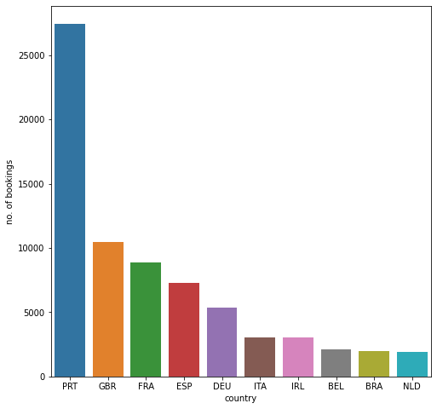
Country wise data analysis
Maximum booking came from PRT country

Slide 21
SUMMARY
Majority of the hotels booked are city hotel. Definitely need to spend the most targeting fund on those hotel.
We also realise that the high rate of cancellations can be due high no deposit policies.
We should also target months between May to Aug. Those are peak months due to the summer period.
Majority of the guests are from Western Europe. We should spend a significant amount of our budget on those area.
Given that we do not have repeated guests, we should target our advertisement on guests to increase returning guests

Slide 22
THANK YOU

